Slide 1
Normalization Rules – Beginners
MELI Seminar @ TAU – 22/04/2018
Moshe Lubliner
Moshe.Lubliner@exlibrisgroup.com

Slide 2
Agenda:
PNX
Publishing Platform
Normalization Rules
Testing the Normalization Rules
Deploys and Pipes types
Local and Lateral fields
Dedup and FRBR groups
Restricted Search Scope

Slide 3
Primo Normalized XML (PNX)
What is PNX?
Primo Record Format,
XML file,
Source data + Normalization Rules set.
View PNX in Front End
Add ‘&showPnx=true’ from the Full Display to the end of the URL,
Recommend Chrome for New UI (Copy options).
PNX Viewer in Primo Back Office
Primo Home > PNX Viewer > Enter Record ID > View PNX,
The record ID is in the URL of the Full Display of a record, in the “docid” parameter for New UI and in the “doc” parameter for the Classic UI.

Slide 4
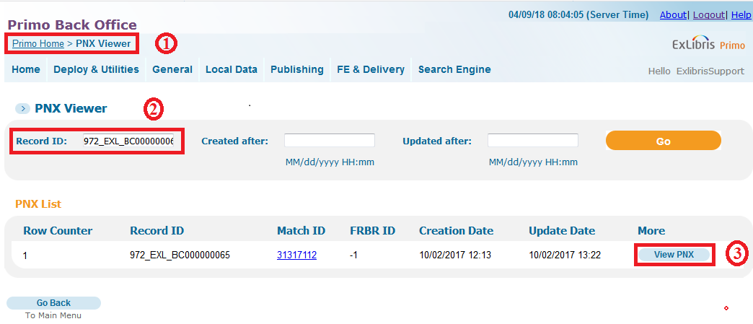
PNX - Exercise
Open any record’s PNX through the Front End (&showPnx=true),
Take the record ID from the URL, and open the record through the PNX Viewer. (Primo Home > PNX Viewer > Enter the Record ID > View PNX).

Slide 5
PNX Viewer

Slide 6
PNX - Sections
Control
Display
Links
Search
Sort
Facets
Dedup
FRBR
Delivery
Enrichment
Ranking
Addata
Browse

Slide 7
Publishing Platform - Introduction

Slide 8
Publishing Platform - Introduction

Slide 9
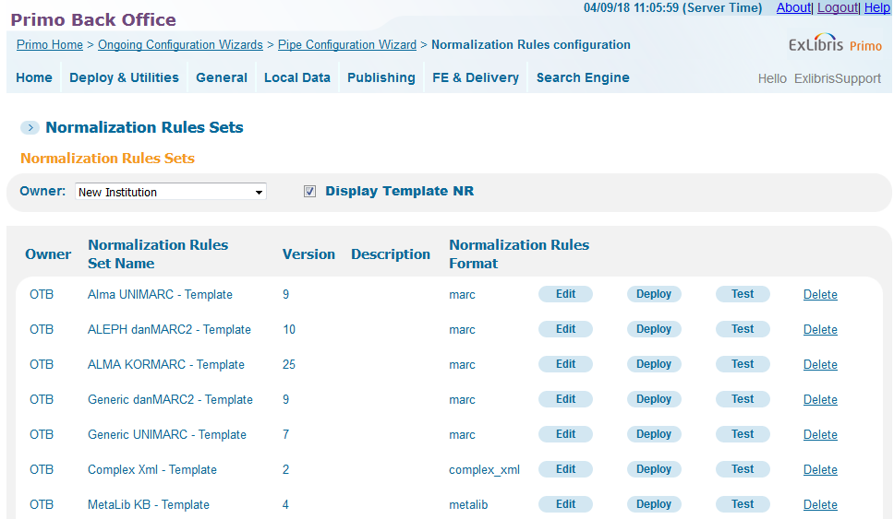
Normalization Rules Templates
Out of the Box,
Meant to be changed,
One template per source record type (Marc, Dublin Core, XML),
Contains the rules that are generally used.

Slide 10
Normalization rules and PNX
Normalization rules for Facets:
Facets configuration starts when the PNX includes the correct values.
Normalization rules for Search:
The indexed fields are in the PNX Search section.
Normalization rules for Display:
The displayed fields are in the PNX Display section.
Normalization rules for FRBR / Dedup members:
The Dedup / FRBR parameters are in the PNX Dedup and FRBR sections.

Slide 11
Normalization Rules: Using and testing.
Configure a rule
Conditions and transformations
Use the True/False parameter
Relate several rules within a field
Test rules
Deploys and Pipes

Slide 12
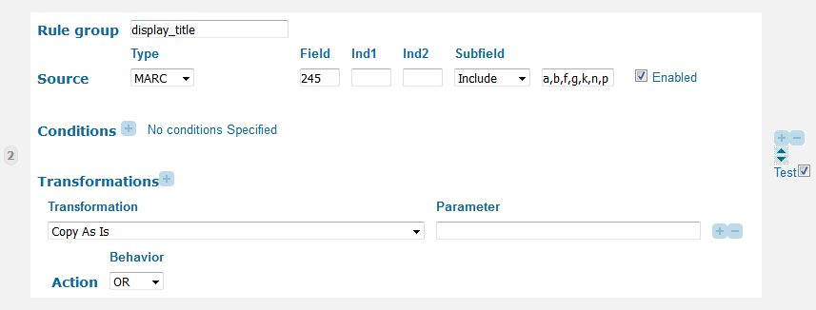
Normalization Rules
Normalization consists of converting data from all sources into a uniform Primo format – PNX.

Slide 13
Normalization Rules
The Normalization rules can be used in Basic mode – without conditions and Actions,
In order to use the Advanced mode, click on Advanced on the rule header.

Slide 14
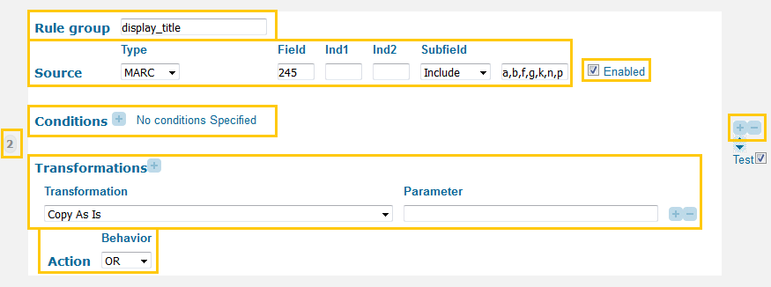
Normalization Rules
The different functionalities of the Normalization Rules Configurations will be detailed in the following slides,
Normalize the value of field 245 subfields a,b,… into the Display/Title Primo field.

Slide 15
Normalization Rules
Rule Group:
Reminds what Primo PNX field we are normalizing data to,
An Underscore is used here, but if using the rule in Source > PNX, a Slash should replace the Underscore. Example: ‘display/title’ and ‘display_title’.
Rule Number:
There position of the rule within the set is important.
Rule Enabled:
Add and remove rules:
Add a rule with the “+” button,
Remove a rule with the “-” button,
Re-order the rules with the Arrows.

Slide 16
Normalization Rules > Source
Source > MARC
Source > PNX
Source > Constant
Source > Config

Slide 17
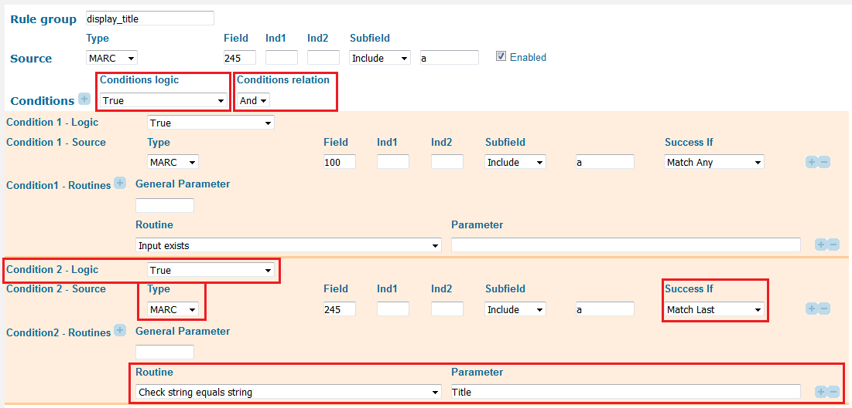
Normalization Rules > Conditions
This rule normalizes the value of field 245 only if there is a value in field 100 |a AND if field 245 |a equals “Title”.

Slide 18
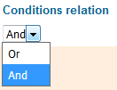
Conditions > Logic and Relation
Conditions Logic
Binary parameter: True or False,
Includes Only the condition or Everything except for the condition,
Two levels: each condition by itself and all conditions.
Conditions Relation
Binary parameter: Or or And,
Only if there are more than one condition,
Describes the relation between conditions,
Means that all conditions, or only one condition must be filled.

Slide 19
Conditions > Logic and Relation Together
This table will help understand the Logic and Relation,
True is always easier to find,
The opposite of “True – Or” if “False – And”.
Conditions logic | Conditions relation | Condition1 logic | Condition2 logic | Result
TRUE | OR | TRUE | TRUE | At least one condition is true.
TRUE | OR | TRUE | FALSE | The first condition is true or the second condition is false.
TRUE | OR | FALSE | FALSE | At least one condition must be false.
TRUE | AND | TRUE | TRUE | Both conditions must be true.
TRUE | AND | TRUE | FALSE | The first condition is true and the second condition is false.
TRUE | AND | FALSE | FALSE | Both conditions must be false.
FALSE | OR | TRUE | TRUE | Both conditions must be false.
FALSE | OR | TRUE | FALSE | The first condition must be false and the second condition must be true.
FALSE | OR | FALSE | FALSE | Both conditions must be true.
FALSE | AND | TRUE | TRUE | Both conditions must be false.
FALSE | AND | TRUE | FALSE | The first condition must be false or the second condition must be true.
FALSE | AND | FALSE | FALSE | At least one condition must be true.

Slide 20
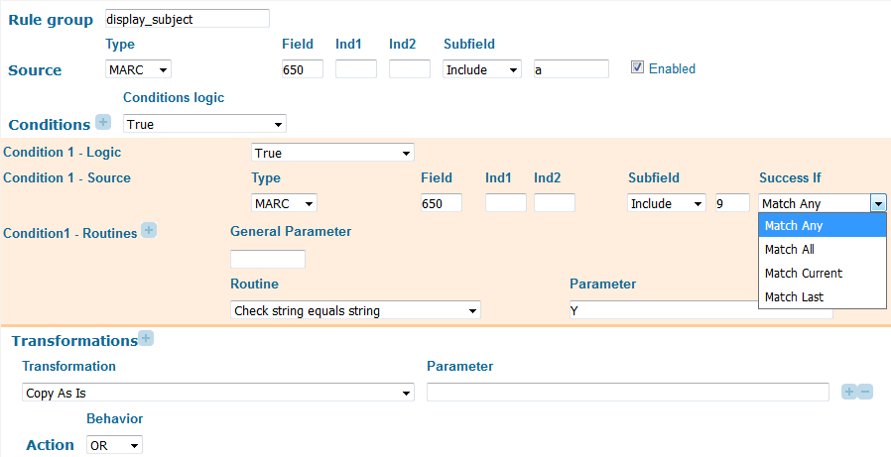
Conditions > Success if
This parameter is important when you have several source fields,
Match Any:
Title
Match Current:
Subject
Contributor
Match All
Match Last

Slide 21
Normalization Rules > Validations and Transformations
How should Primo modify the value of the condition / source field (Transformations),
What should I verify in each condition (Validations).
In the Conditions section, both Validations and Transformations are needed,
In Transformations, only Transformations should be used.
A Validation generally starts by ‘Check’, ‘Validate’, ‘Starts with’,
A Transformation generally starts by ‘Add’, ’Delete’, ’Format’, ’Replace’, …

Slide 22
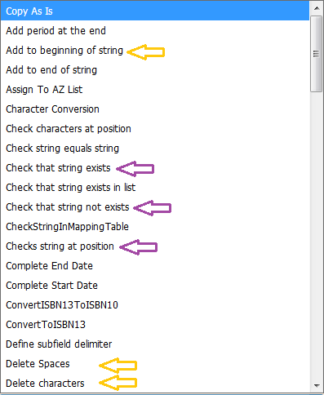
Normalization Rules > Validations and Transformations
Examples of Validations:
Check that string exists,
Check string at position.
Examples of Transformations:
Copy as is,
Delete Spaces,
Delete characters.

Slide 23
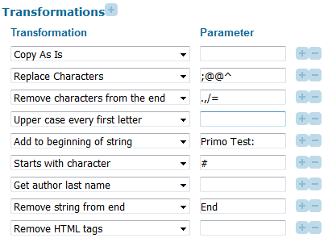
Validations and Transformations > Parameters
Some validations and transformations are using a parameter, and some are not.
Transformations with a parameter:
Check string equals string,
Remove characters from the end,
Add to the beginning of string,
Starts with.
Transformations without parameter:
Copy as is,
Upper case every first letter,
Input exists.

Slide 24
Transformations > Examples
Example 1:
+

Slide 25
Transformations > Examples
Example 2:

Slide 26
Normalization Rules > Actions
Configures the relation between the different rules of the same PNX field
Add – Each rule can create a different PNX field.
Example: Contributor, Subject.
Or – Only the first of the connected rules creating a value is used.
Example: Display>Type.
Merge – Connects the values created by the connected rules into one PNX field.
Example: Control>RecordID.
First Delimiter: defines the behavior between merged values,
Repeat numbers: Defines how many times to apply the behavior above,
Remaining delimiters: Defines the behavior for the remaining merged values.

Slide 27
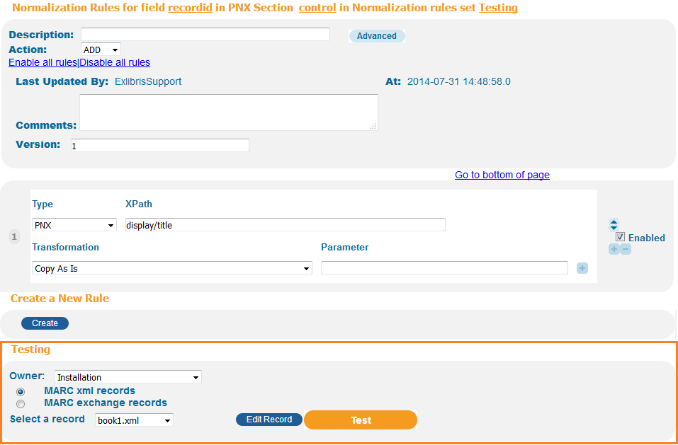
Test Normalization Rules
A single rule can be tested
within the Normalization Set
Editor,
The whole set can be
tested from the Normalization
Rules Sets page.

Slide 28
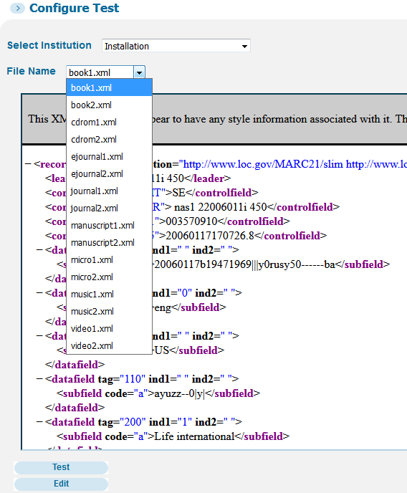
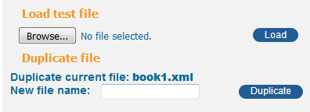
Test Normalization Rules > Input
Choose the test file that you wish to use,
Primo comes Out-of-the-Box with several test files,
Test files can be added or modified from Primo Back Office,
Removing test files has to be done through Exlibris support – Please open a case,
Recommend using ‘Duplicate file’.

Slide 29
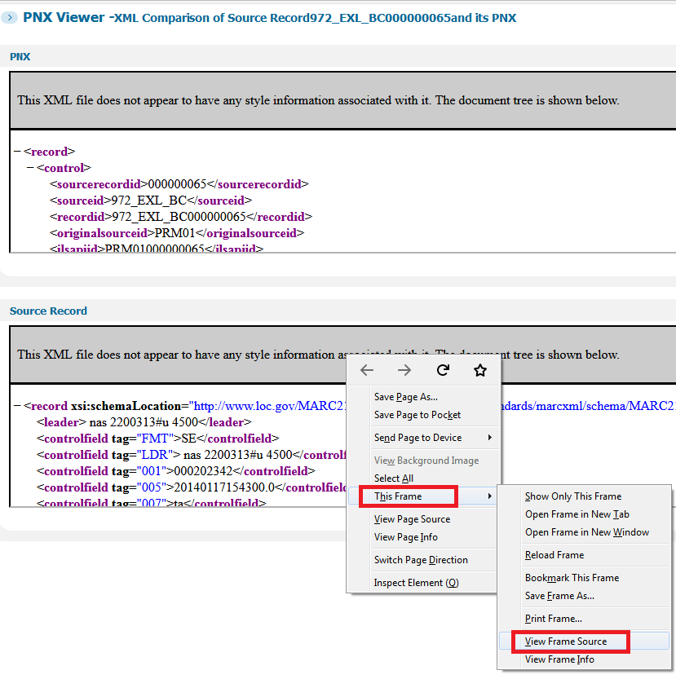
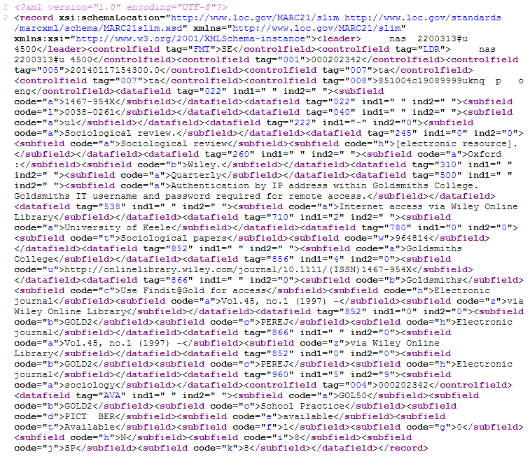
PNX – View Source Record > Test Normalization rules

Slide 30
Test Normalization Rules > Output

Slide 31
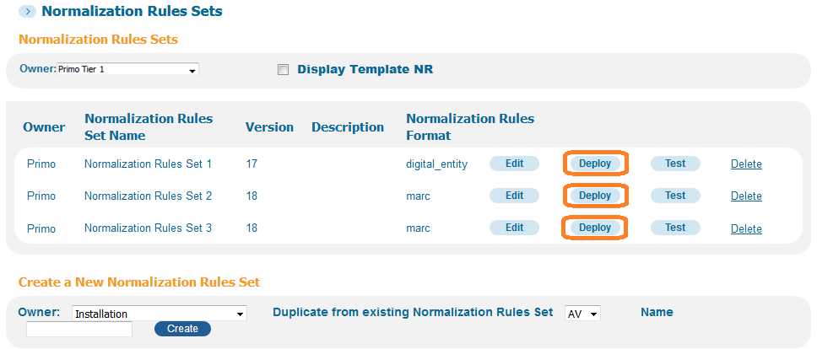
Deploys
A deploy to the Normalization Rules Set should be applied after each Saved modification to the set,
Deploys are applied per Normalization rules Set.

Slide 32
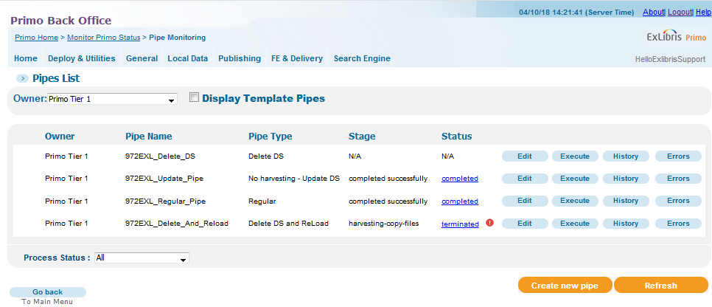
Pipes
4 different types of Pipes

Slide 33
Questions before practicing?

Slide 34
Practice – Create a test file using Duplicate file
Access the Test NR screen
Create a test file using “Duplicate file” Edit and insert one of your records
Edit a rule on a field that is currently not used, for example field Display> lds125 (press “Display Empty PNX fields” in the Display/Section page)
Do NOT save or deploy the Normalization Rules Set during the tests!
Remember what field you are editing, and if the field is used, take a screenshot.

Slide 35
Practice – Using transformations and conditions
Create a rule (MARC based) and test it with one condition, and two different transformations.
Create a rule with two related conditions with at least one condition logic set to False.
Create two rules with 2 conditions and 3 transformations on each rule.
Create a rule from a multiple values source field and use “Success If”.

Slide 36
Local fields
Lateral fields
Dedup
FRBR
Restricted Search Scopes

Slide 37
Local fields
Local fields available:
Display (lds) – Up to 200
Search (lsr) – Up to 50
Links (lln) – Up to 50
Facets (lfc) – Up to 50
Enrichment (lrn) – Up to 50
Sort (lso) – Up to 50
Addata (lad) – Up to 25
Configuration:
Modify the NR set, save and deploy
Run the Update Pipe, and then
Display – Views Wizard and Code tables
Search– Wait for Indexing
Links– Views Wizard and Code tables
Facets:
Dynamic – ‘Facet Labels’ code table
Views Wizard
Static – Several Mapping and Code tables Views Wizard
More information here and here

Slide 38
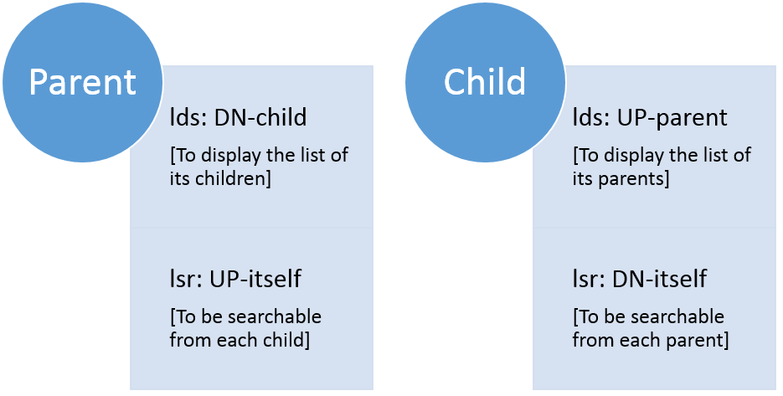
Lateral fields
Display and search local fields 30-39 only
The display and search fields are connected and need to be identical
Possible to differentiate between the value to display and the value to search
Example: <lds33>Child record’s Title$$Q990001026730203616</lds33>
Clicking on the lds33 field will search the Child record in the lsr33 field only!
Two rules (lds – lsr) must be created and tested
The same field number should be used for lds and lsr

Slide 39
Dedup Process
In case identic items are found.
Example: Physical and Digital version of the same MMS ID
Dedup fields in each record’s PNX create a Dedup Vector for each record
During the pipe, the Dedup vectors are compared and if a match is found, the records are “Dedup’ed”.
Only the Dedup newly created record is indexed and displayed
It is possible to prevent the DEDUP process by setting the field DEDUP/c value to 99

Slide 40
Dedup Process

Slide 41
FRBR Process
In case different versions of the same item are found.
Example: 3 different editions of the same book.
FRBR fields in each record’s PNX create a FRBR Vector for each record
During the pipe, the FRBR vectors are compared and if a match is found, the records are “FRBR’ized”.
All FRBR group members are indexed and displayed
In the Brief Results, only the “Preferred record” is displayed
It is possible to prevent the FRBR process by setting the field FRBR/t value to 99

Slide 42
FRBR Process

Slide 43
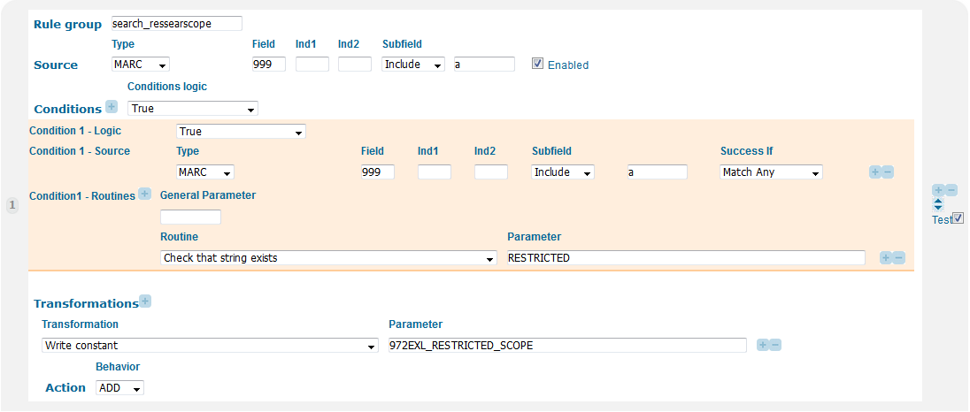
Restricted Search Scopes > Step 1
Normalization Rules > Search section > Ressearchscope field.
Save, Deploy, and run the Update pipe.

Slide 44
Restricted Search Scopes > Step 2
Primo Home > Local Data tab > Restricted Search Scopes.
Only non signed in users On campus - in this case – are allowed.

Slide 45
Questions?

Slide 46
Moshe.Lubliner@exlibrisgroup.com

