Slide 1
Advanced Normalization Rules
MELI Seminar @ TAU. 23/4/18
Lior Rudel

Slide 2
סדר יום כללי
10:00: סבב היכרות קצר – מקום עבודה ואופי העבודה על פרימו
הדרכה חלק ג'
הדרכה חלק א'
סדנה מעשית
הדרכה חלק ב'
סדנה מעשית
הפסקת צהריים
סדנה מעשית
15:30: סיכום ושאלות

Slide 3
היכרות
עבודה בפרוייקט דיגיטציה של אונ' הרווארד.
תפקיד הדרכה בספריית מכון סאלד.
באקסליבריס מאז 2013.
SFX.
TOTAL – CARE.
Primo.

Slide 4
חלק א' משאבי מידע PNX The Core functionality and the Magic of Primo How to work with NR Structure of a Rule, and relation between rules

Slide 5
משאבי מידע
PNX Record Sections
Subfields in the PNX
Enhanced Hypertext Linking
Primo Administration

Slide 6
PNX?
MARC XML
PNX
Primo Record

Slide 7
PNX?
MARC XML
PNX
Display & Links
Search
Facet
Delivery
Sort
Dedup & FRBR
Availability
Ranking
Additional Data
Browse

Slide 8
The Core functionality and the Magic of Primo
הערכים הנמצאים ברשומה משפיעים על התפקוד ואופן הפעולה של פרימו.
כיצד? נראות, חיפוש, עידון, ניקוד, דפדוף, שירותי השאלה ושירותי אונליין.
באיזה אופן הרשומה תוצג? סוג המשאב, כותר, מחברים, שנת הו"ל וכו'.
אילו שירותים יתלוו אליה? בקשת או השאלת פריט פיזי, קישורים להעשרת הרשומה, קישורים חיצוניים, קישורים למאמר או ספר בטקסט מלא.
מיקום הכותר בזמן אמת
ועוד..

Slide 9
Publishing Platform – a few words
ILS export file
Primo Harvesting pipe
Primo index and hotswapp
During the pipe Primo is processing the XML records within the extracted export file, against the Normalization rules in order to create the PNX records.

Slide 10
Display:availibrary מיקום בזמן אמת
$$I — institution code (required)
$$L — library code (required)
$$1 — sub-location
$$2 — call number
$$S — availability status (available, unavailable, check_holdings) (required)
$$3 — number of items
$$4 — number of unavailable items
$$5 — multi-volume flag: Y/N
$$6 — number of loans (for ranking purposes)
$$9 — indicates that the location represents online material. For more information, refer to Adding $$9ONLINE to Library Level Availability.
$$X — source institution code (required for OvP)
$$Y — source library code (required for OvP)
$$Z — source sublocation code (not required for OvP)
Primo Generates the API Call based on these parameters, ILS Provide an XML including the current AVA fields in response. The XML is checked against the rules.xml per source and pipe, and creates the RTA line. If it fails on any phase the indication will display the location and status as per the PNX current.

Slide 11
Delivery:delcategory – אפיון וקביעת השירותים
Source
PNX
Institution
Category code
Calculation
Mapping Table
Delivery Manager
Result
Aleph: FMT Ldr
Alma: INT
View it
Get it

Slide 12
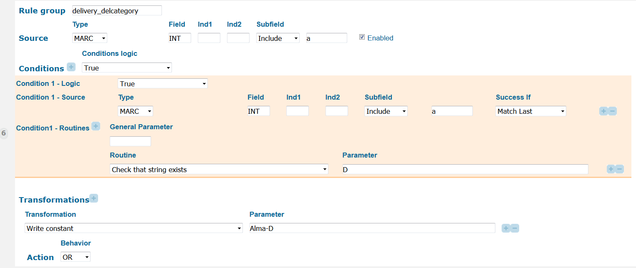
Delivery:delcategory – אפיון וקביעת השירותים
Source:
נקבע ע"י עלמא
Rule:

Slide 13
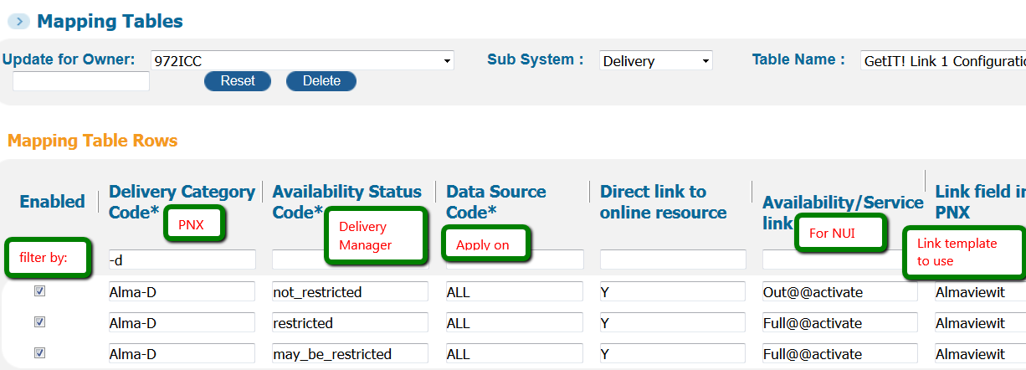
Delivery:delcategory – אפיון וקביעת השירותים
Result in PNX:
Mapping table > Delivery > GetIT! Tab 1 Configuration:

Slide 14
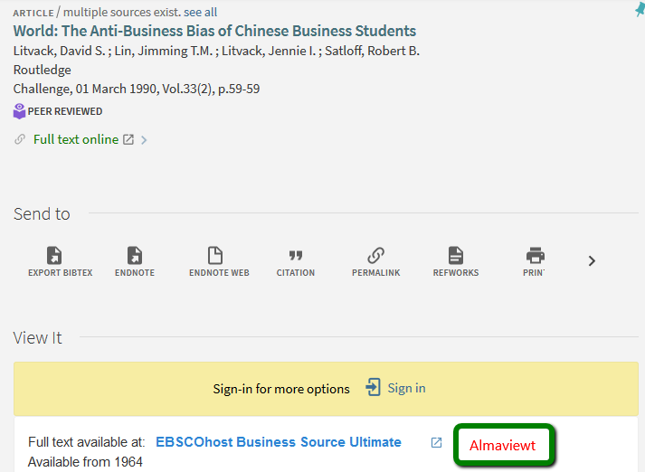
Delivery:delcategory – אפיון וקביעת השירותים
Mapping table > Delivery > Templates:
Result:

Slide 15
How to work with NR
Creating a normalization rules set
Create it from a TEMPLATE!

Slide 16
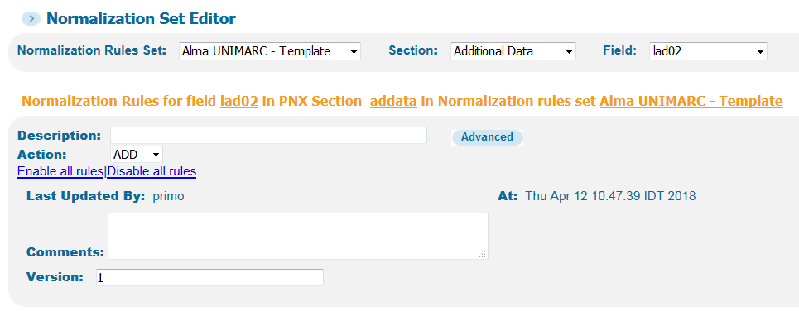
How to work with NR
Different Sections of the rules editor page:

Slide 17
How to work with NR
Different Sections of the rules editor page:

Slide 18
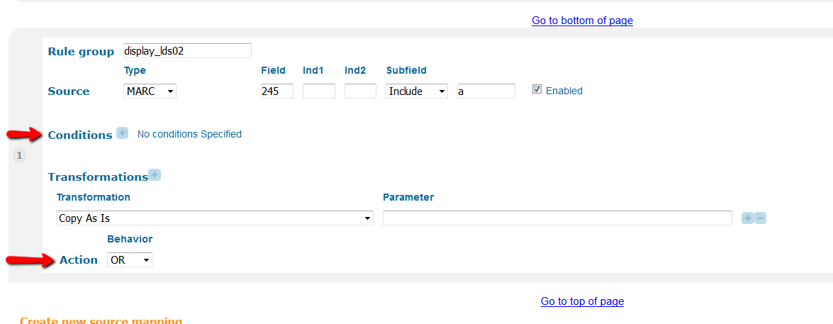
How to work with NR
Different Sections of the rules editor page:

Slide 19
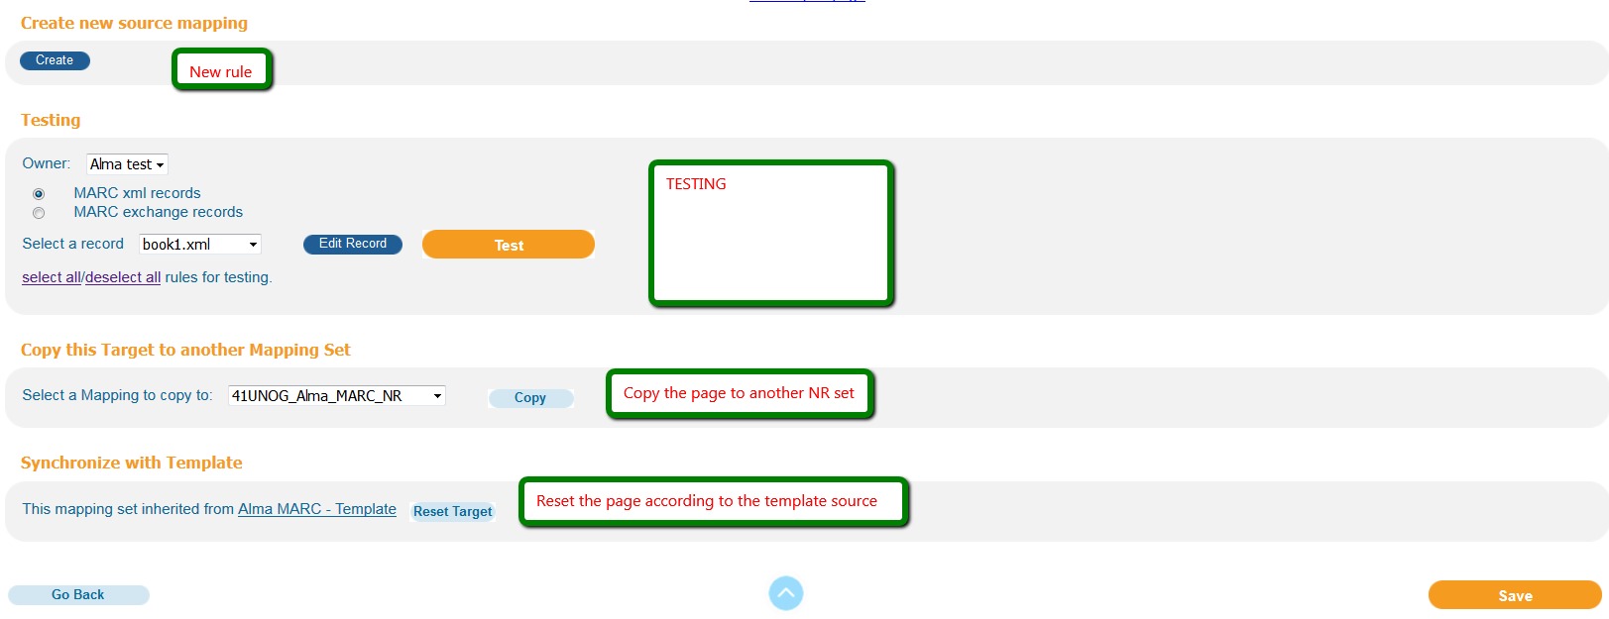
How to work with NR
Different Sections of the rules editor page:

Slide 20
How to work with NR
Different Sections of a Rule:

Slide 21
How to work with NR
Different Sections of a Rule – Source
The source can be the MARC, a pre defined PNX filed, a constant text and Configuration Xpath.

Slide 22
How to work with NR
Different Sections of a Rule – Conditions
Conditions logic: True or False
Conditions Relation:
This appears when there are more than one conditions defined. The available values are:
AND – Indicates that all conditions must be met for the condition to be true.
OR – Indicates that at least one of the conditions must be met for the condition to be true.

Slide 23
How to work with NR
Different Sections of a Rule – Conditions

Slide 24
How to work with NR
Different Sections of a Rule – Conditions - Success if
Match Any - Using match any, means that the condition is true for any occurrences of the source field.
Match all – the condition must be true in all occurrences of the source fields.
Match current – the condition is true in the current source field. For example, if there are three source fields, the condition will be checked in the field being worked on. If you want the rule to work based on another subfield in the same field, use match current.
Match Last - In single occurrence we will use Match Last. indicates that condition is true for the last occurrence of the source field. This is the default.

Slide 25
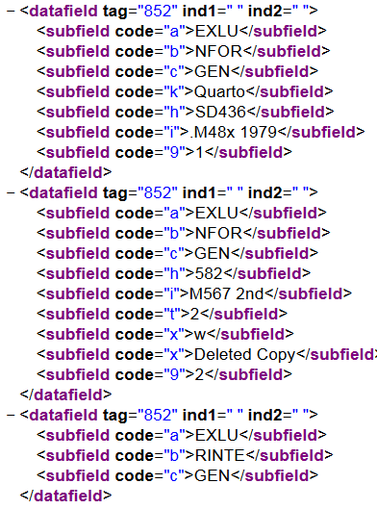
How to work with NR
Different Sections of a Rule – Conditions - Success if

Slide 26
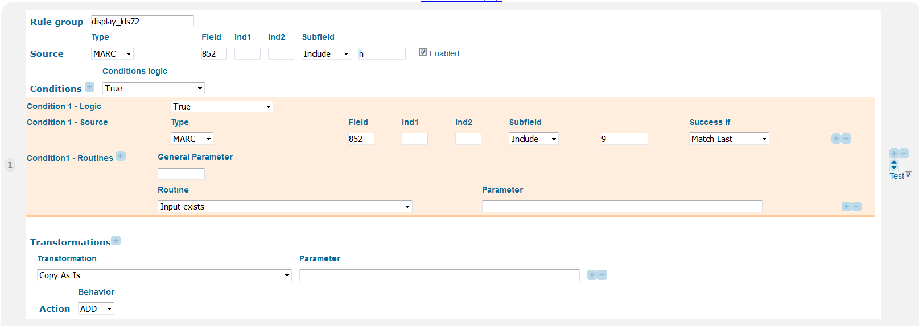
How to work with NR
Different Sections of a Rule – Conditions - Success if

Slide 27
How to work with NR
Different Sections of a Rule – Conditions - Success if
Match Last: Nothing
Match Last - indicates that condition is true for the last occurrence of the source field. As 852 9 exist on both occurrences of 852, then the condition is not met.
Match Any: Both first
Using match any, means that the condition is true for any occurrences of the source field.
As 852 9 exist on both occurrences of 852, then the condition is not met.
Match All: Nothing
The condition must be true in all occurrences of the source fields, and as the last 852 dose not contain subfield 9, the condition is not met.
Match Current: Both first
The condition is true in the current source field. For example, if there are three source fields, the condition will be checked in the field being worked on.

Slide 28
Exercise

Slide 29
חלק ב' Using Mapping Table TEST utility XML file Rules.xml Routines

Slide 30
Using Mapping Table
For Normalization and Delivery
Normalization mapping tables are used during the normalization process to translate multiple values from the source record to multiple values in Primo.
When the original source records go through the normalization process, most of the fields are mapped directly by the normalization rules. However, there are some fields that are sent to the normalization mapping tables first.

Slide 31
Using Mapping Table
Some of the normalization mapping tables are used to identify values in the leader, 007 and 008 fields in different
forms of MARC data to determine genre and resource type.
Other mapping tables are used to map institution and library codes so that the full names of the institutions and
libraries can display correctly.
Today we’re going to take a closer look at a customized CheckStringInMappingTable mapping table, and see how it works.

Slide 32
Create a New Code Table

Slide 33
Mapping Table – source* and target

Slide 34
Export and Import
Export to Excel and create new file based on the exported file:
Enabled | sourceCode1 | targetCode | Description | InstallationCode | InstitutionCode
true | text | Primo is FUN |  | CUSTOMER | TIER1
true | MELI_PNX | Meli Seminar |  | CUSTOMER | TIER1
true | Lior_PNX | Lior |  | CUSTOMER | TIER1
true | TAU_PNX | Tel-Aviv University |  | CUSTOMER | TIER1

Slide 35
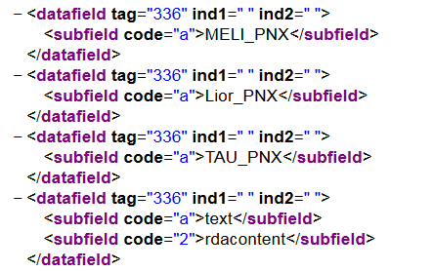
Creating a Rule to that is using the MT
Source and Rule:

Slide 36
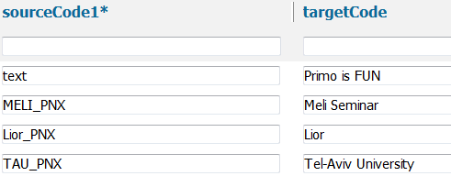
Creating a Rule to that is using the MT
Save the Rule
Deploy the set
Save and deploy the Mapping table.
Test the set:
Outcome:

Slide 37
Another look on the process

Slide 38
How to use Template URL
From the Links section
Inspect your URL in the source
Is the URL needs to use a placeholder for a variable?

Slide 39
How to use Template URL
Source:
<datafield tag="336" ind1=" " ind2=" ">
<subfield code="a">https://repositorio-aberto.up.pt/handle/
</subfield>
<subfield code="b">10216</subfield>
</datafield>
<datafield tag="400" ind1=" " ind2=" ">
<subfield code="a">16786</subfield>
</datafield>

Slide 40
How to use Template URL
Create a new row in the Delivery > Templates MT:
template_test
https://repositorio-aberto.up.pt/handle/{{1}}/{{2}}
Save and Deploy Delivery Settings (GetIt and Availability)

Slide 41
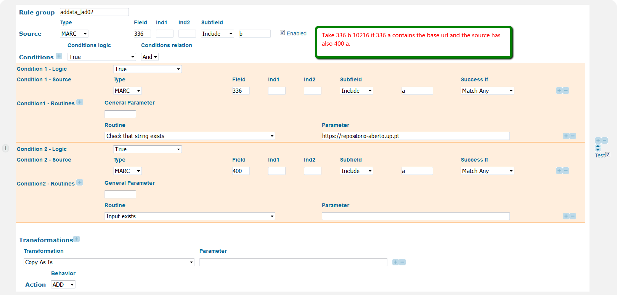
How to use Template URL
For the example , Go to local addata field e.g lad02

Slide 42
How to use Template URL

Slide 43
How to use Template URL
Outcome is:
<lad02>10216/16786</lad02>
Save, deploy

Slide 44
How to use Template URL
Save, deploy, execute the no-harvest pipe. Outcome is:

Slide 45
Create XML
Always use the correct Schema – MARC 21 Example
<?xml version="1.0" encoding="UTF-8"?>
<record xsi:schemaLocation="http://www.loc.gov/MARC21/slim http://www.loc.gov/standards/marcxml/schema/MARC21slim.xsd" xmlns="http://www.loc.gov/MARC21/slim" xmlns:xsi="http://www.w3.org/2001/XMLSchema-instance">
<datafield tag="041" ind1=" " ind2=" ">
<subfield code="a">eng</subfield>
</datafield>
</record>

Slide 46
Create XML
Always use the correct Schema – OAI_DC Example
<?xml version="1.0" encoding="UTF-8"?>
<oai_dc:dc xmlns:ns2="http://purl.org/dc/terms/" xmlns="http://purl.org/dc/elements/1.1/" xmlns:oai_dc="http://www.openarchives.org/OAI/2.0/oai_dc/">
<title xml:lang="eng">American liberal education and the civic university:‘citizenship’ and ‘learning’ at the American University of Beirut</title>
<creator>Kiwan, Dina</creator>
<ns2:isPartOf>urn:ISSN:0435-3684</ns2:isPartOf>
</oai_dc:dc>

Slide 47
Create XML for MARC and DC
https://melinr.weebly.com/day-2.html

Slide 48
Create XML for MARC and DC

Slide 49
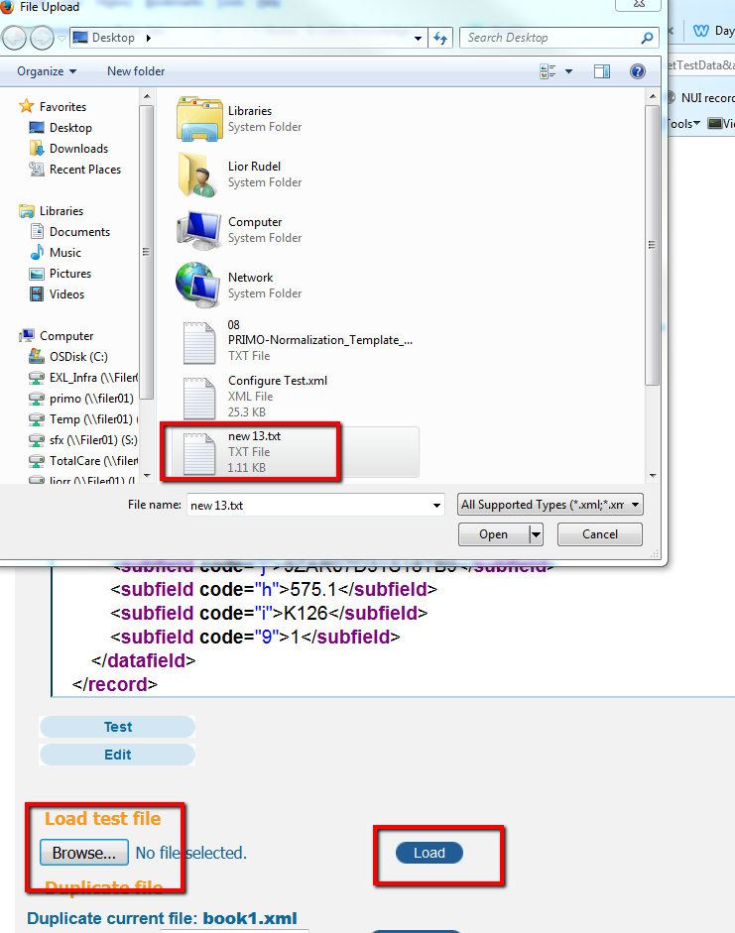
Create XML for MARC and DC

Slide 50
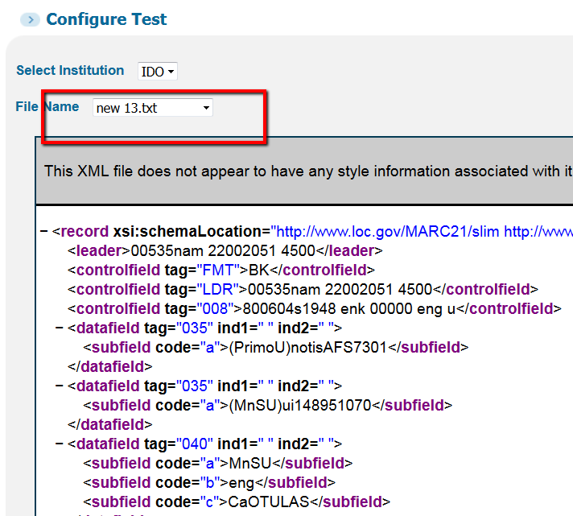
Create XML for MARC and DC

Slide 51
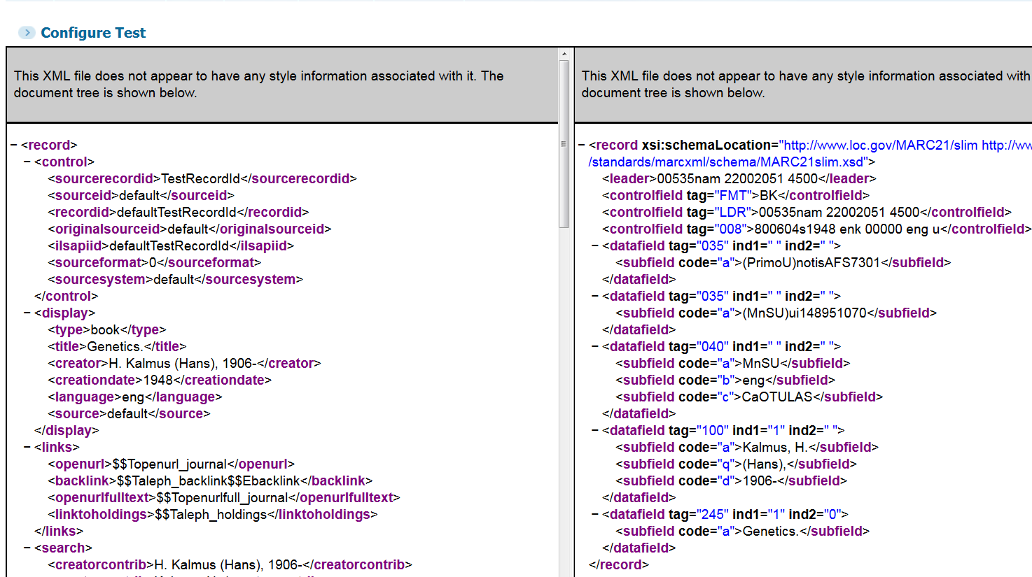
Create XML for MARC and DC

Slide 52
Create XML for MARC and DC
Test DC on NR that is generated to work with DC:
Alma Dublin Core - Template
DigiTool DC - Template
Generic Dublin Core - Template
Rosetta - Template

Slide 53
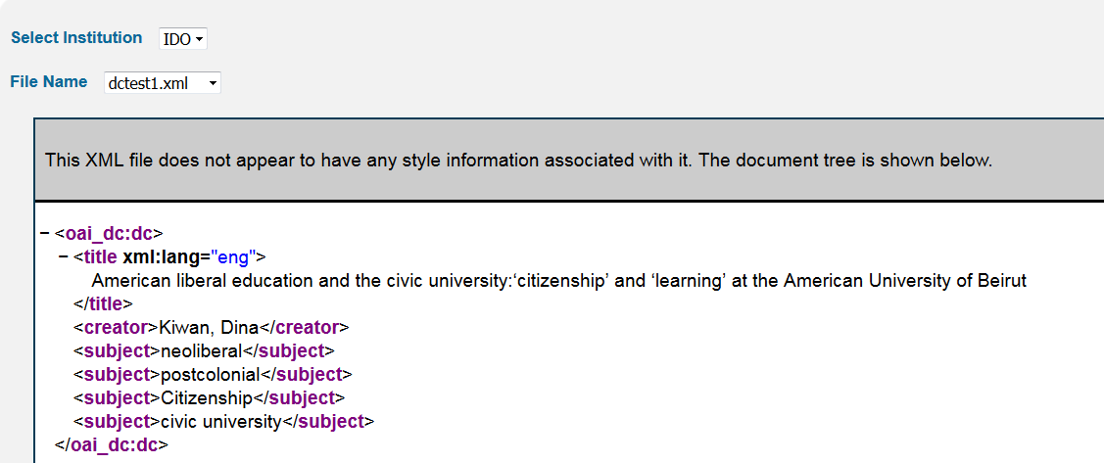
Create XML for MARC and DC

Slide 54
Rules.XML
The file that is used by the pipe to normalize the records.
When creating a pipe you need to choose the data source and the Normalization set that it should use.
When Deploying the NR set, the file is recreated and is used by the pipe.

Slide 55
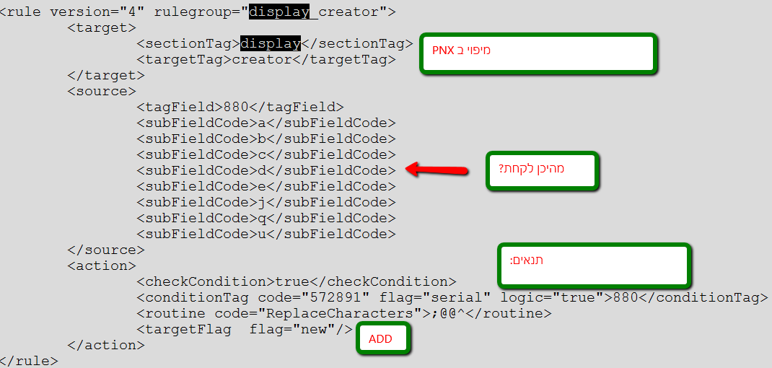
Rules XML

Slide 56
Routines
Transformation Routines:
תפקידם לשנות את הערכים המגיעים מהקטלוג לערכים אחרים בעבור צרכי תצוגה וחיפוש
Validation Routines:
תפקידם לעזור בהגדרת התנאים ולבדוק על השדות עצמם תנאים מסויימים.

Slide 57
Validation Routines examples

Slide 58
Transformation Routines examples

Slide 59
Exercise
Work with mapping table on a new set
Create mapping table
Create XML
Deploy
Test
We are not running pipes today.
Create xml
Upload xml
Using examples use the routines

Slide 60
חלק ג' PNX subfields Local fields Dublin Core Dedup and frbr Lateral Linking Rule Grouping – when we use it and how

Slide 61
PNX subfields
ניתן להשתמש בתתי שדות למטרות שונות
https://knowledge.exlibrisgroup.com/Primo/Product_Documentation/Technical_Guide/010The_PNX_Record/020Subfields_in_the_PNX
200 local fields for display, 50 for search, Links, facets.
For addata – 25.

Slide 62
Local fields
For search make sure the configuration is correct

Slide 63
Dublin Core and other XML formats
Primo can work with many types of cataloging and provide OTB Dublin core templates.
Descriptor <creator> path: dc

Slide 64
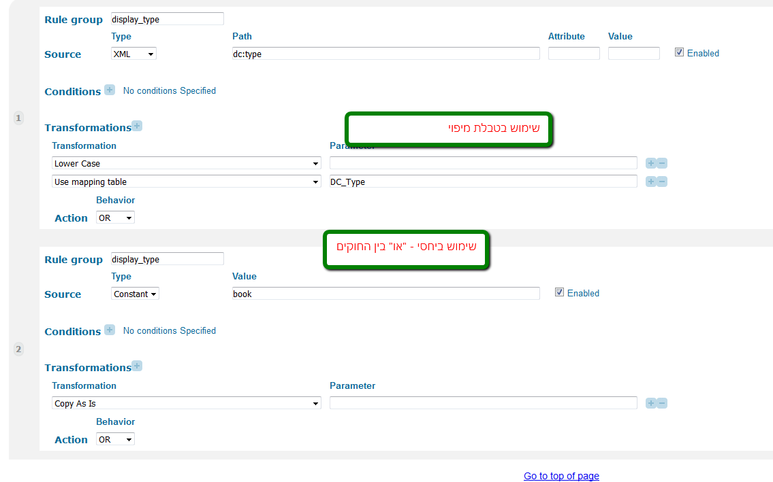
Dublin Core and other XML formats
Example:

Slide 65
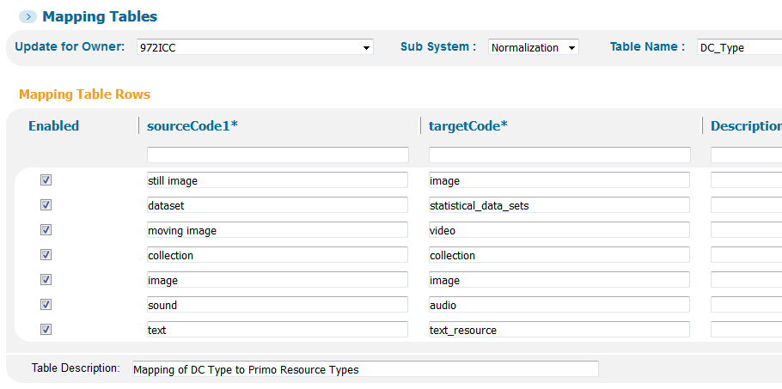
Dublin Core and other XML formats
Example:

Slide 66
Dedup and FRBR
DeDup
Identifies records representing the same item
Replaces them with a new unified record
Display comes from a preferred record
selected at creation of the PNX!
Incorrect deduplication usually due to data issues

Slide 67
Dedup and FRBR
FRBR
Gathers similar records into a group
All the group members can be seen in Primo
Displays a preferred record selected when you search!
Incorrect FRBR usually due to what data is being normalized

Slide 68
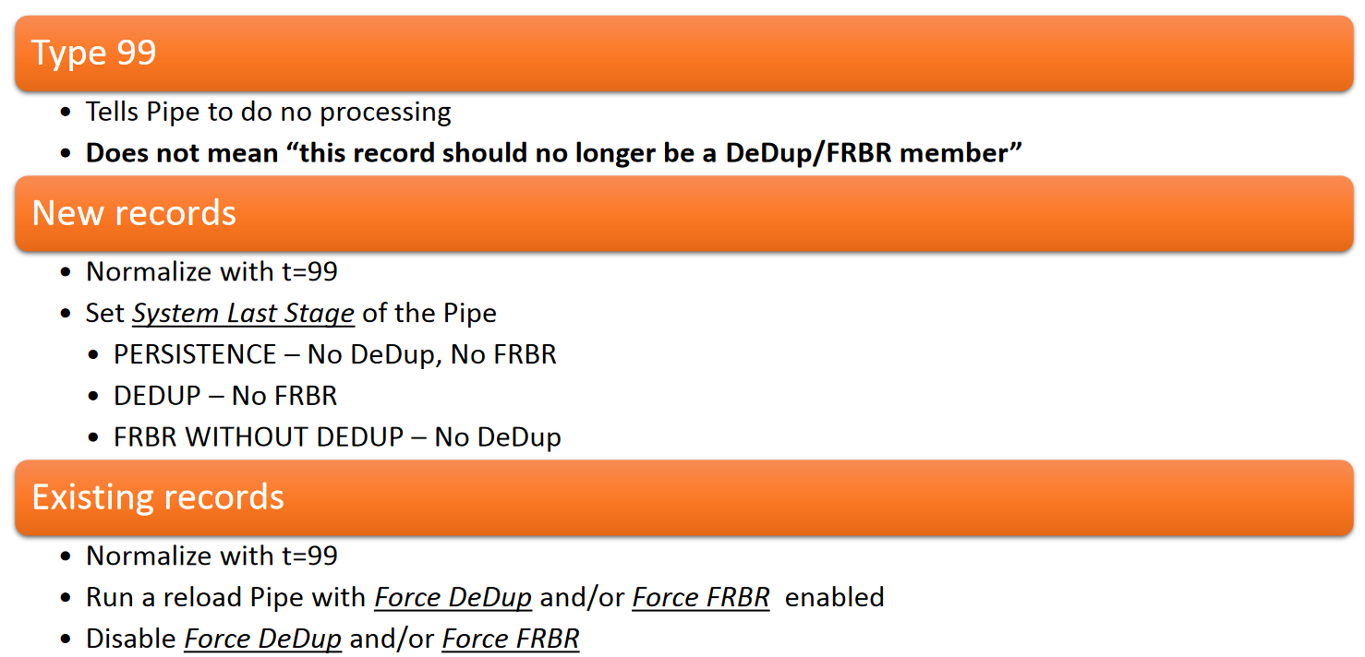
Dedup and FRBR - Preventing DeDup or FRBR

Slide 69
Dedup and FRBR
Duplicate Detection Vector
The FRBR Vector
How can we know if a record is part of a FRBR group?

Slide 70
Rule Groups
The Rule group field defines which rules the system will process together as a group.
By using modified rule group it is possible to create a group of rules that have different sources.

Slide 71
Rule Groups
For Example: display_creator.
Note that the rules use different source fields (MARC tags), which include 880, 100, 110 and 111. The system processes all of the rules with the same source tags, starting with the 880 fields, followed by the 100 fields, the 110 fields, and so forth.

Slide 72
Rule Groups
Using the following XML source, this example merges the surname and given-names elements into the display/creator field:
<contrib contrib-type="author">
<name>
<surname>Alarcon</surname>
<given-names>Graciela S.</given-names>
</name>
</contrib>
<contrib contrib-type="author">
<name> <surname>Westfall</surname>
<given-names>Andrew O.</given-names>
</name>
</contrib>
<contrib contrib-type="author">
<name> <surname>Lim</surname>
<given-names>Sam S.</given-names>
</name>
</contrib>

Slide 73
Rule Groups
To merge these elements together, you must configure the following rules, using a modified Rule group:
Rule #1:
Rule group: display/creator_1
Source Type: XML
Source Path: contrib/name/given-names
Transformation: Copy as is
Action: ADD
Rule #2:
Rule group: display/creator_1
Source Type: XML
Source Path: contrib/name/surname
Transformation: Copy as is
Action: MERGE, no delimiter, space After

Slide 74
Rule Groups
These rules generate the following output:
display/creator Graciela S Alcon
display/creator Andrew O.Westfall
display/creator Sam S. Lim
If you had not modified the rule group, these rules would have generated the following output, processing each source separately:
display/creator Graciela S
display/creator Andrew O.
display/creator Sam S. Alcon Westfall Lim

Slide 75
Lateral Linking
1. NR for Parent records > Display section > lds30 > add a rule pointing to a Child record. 2. NR for Parent records > Search section > lsr31 > add a rule pointing to itself - the same Parent record. 3. NR for Child records > Display section > lds31 > add a rule pointing to a Parent record. 4. NR for Child records > Search section > lsr30 > add a rule pointing to itself - the same Child record.

Slide 76
Exercise
Continue to build the NR

